Slide 1
Coursera Capstone
San Francisco Neighborhoods Clustered by Restaurant Price

Slide 2
Introduction
Where in San Francisco is a good place for a cheap restaurant? An expensive restaurant? A new location for a chain restaurant?
The generally accepted reputation of each SF neighborhood may not be enough: let’s study them and their similarities to get a better picture
We will use FourSquare, and K-Means clustering and provide a map suggesting possible good areas for a restaurant.

Slide 3
Data
Official SF neighborhoods: https://sfplanning.org/resource/neighborhood-group-organizations
Use Nominatim to find coordinates of each neighborhood, use Google Maps or Wikipedia if Nominatim is insufficient
Use FourSquare to find restaurants in each price bucket in a 500m radius from each neighborhood coordinate
Use price segmentation to cluster neighborhoods into 4 separate clusters

Slide 4
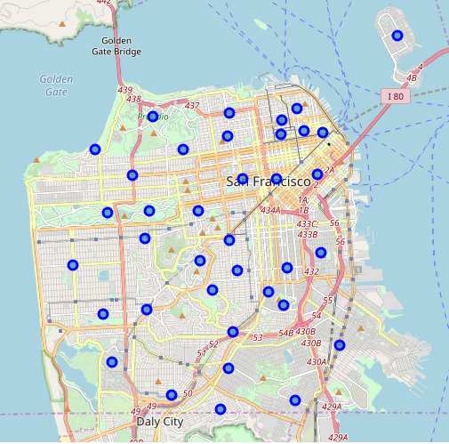
Results Background
After cleaning up Nominatim’s geocoding, here is a map of our neighborhoods of SF, using Folium.

Slide 5
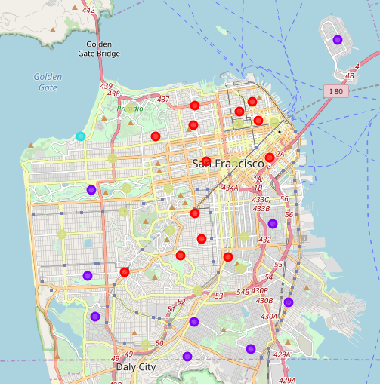
Results
After clustering, here are our grouped neighborhoods
Red: $$$$
Green: $$-$$$
Purple: $-$$
Blue: ? (No nearby restaurants)

Slide 6
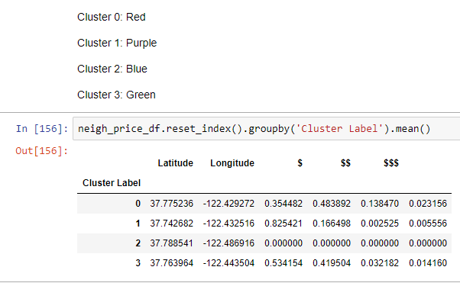
Results Data
Means of the frequency of each bucket of restaurant is given here, supporting the classification of each cluster given last slide

Slide 7
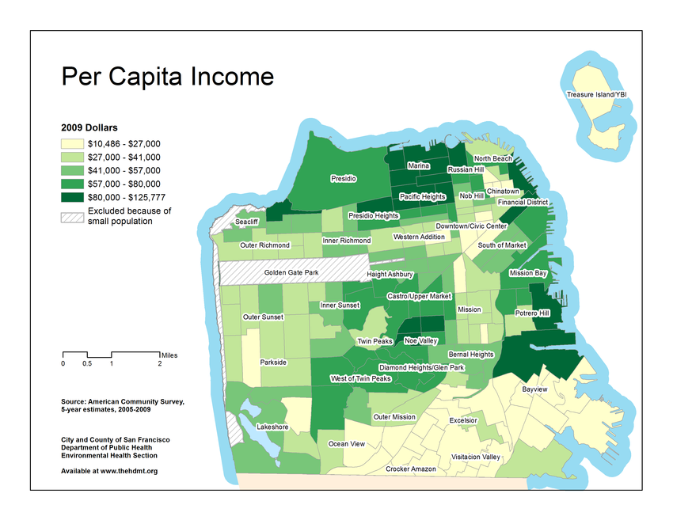
Discussion
Similarities to Per Capita Income do exist, but it’s not exactly 1:1
Wealthy neighborhoods may have many cheap restaurants, or vice versa
People in wealthy neighborhoods may travel farther outside of their neighborhood for food

Slide 8
Discussion
The clusters were separated almost geographically, but this was done without any coordinate information given to the K-Means clustering
This indicates that geography certainly is related to restaurant pricing: closer to downtown is usually more expensive
The Downtown/Civic Center, Chinatown, and Nob Hill neighborhoods are very interesting, as they are Green clustered neighborhoods within a location of mostly Red clusters.
Suggestion to restaurateurs would be to pick a cluster that matches with their intended restaurant price range
Could also choose a neighborhood with dissimilar restaurants for less competition, up to the businessperson to decide.

Slide 9
Conclusion
Using Nominatim/Folium/FourSquare/Kmeans clustering, similar neighborhoods have been mapped out with general restaurant pricing data. This can be used to help a restaurateur choose where to put a new restaurant.
Future study:
  restaurant pricing vs average income neighborhood mismatches?
  genres of restaurants in each area
  Concentration of restaurants in each neighborhood
  Diversity of price ranges in each neighborhood

Slide 10
Thanks

